Slide 1
Housing AI
Predictive Insights: Anticipating Housing Needs in the Future

Slide 2
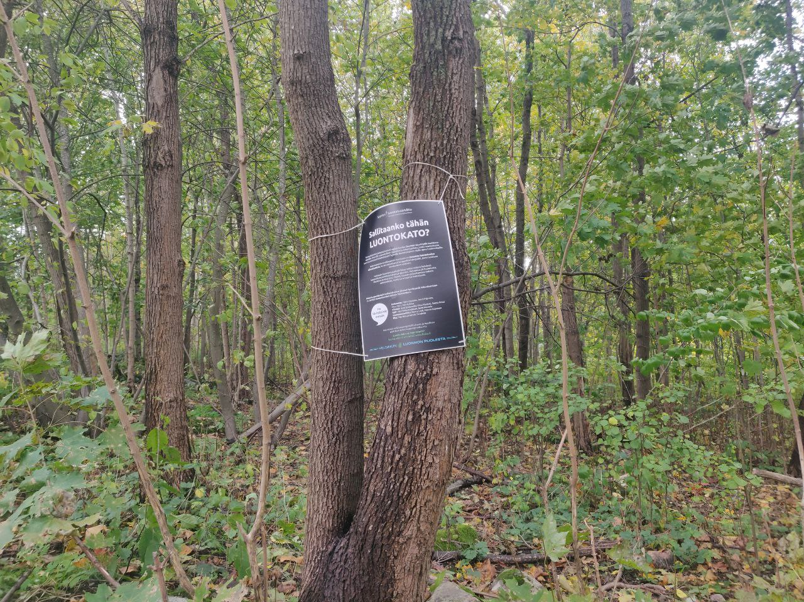
Did You know?
“Will we allow biodiversity loss here?”

Slide 3
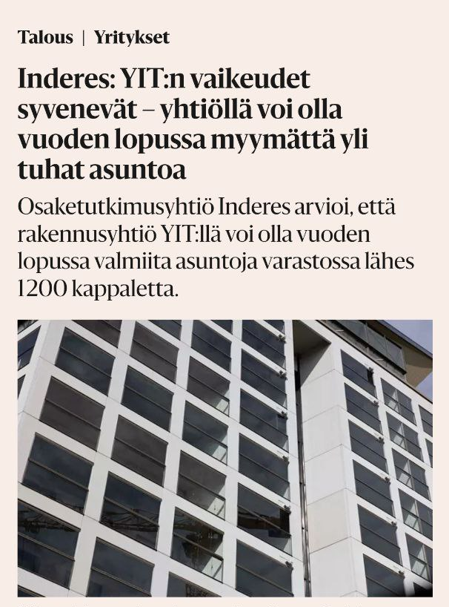
Building company:YIT may have more than one thousand unsold apartments by the end of the year.

Slide 4
Problem
How many people want to move to the city in the future?
In which areas are they willing to move?
Objective
Anticipate the amount of houses in future.

Slide 5
Solution
Utilizing predictive analytics, gathering and analyzing historical data and creating predictive models for housing demand.
Target Group/End Users
City planners/ building companies

Slide 6
Benefits
For City Planners
They can have accurate predictions in long-term urban planning.
Informed decision-making
For Building Companies
Reduced Business risk
Optimized resource allocation
For Environment
Minimizes ecological Impact

Slide 7
Thank You!

